Slide 1
Week 3 Assignment
Haochen Yang

Slide 2
Problem 1
First, I obtained the necessary formulas from class notes
Second, I performed exponentially weighted covariance on the given stock return, with lambda used to assign different weight to stock returns at different time spots.
Third, we performed PCA to calculate the cumulative variance explained by eigenvalues.

Slide 3
Problem 1
Similarity: all increase from 0 to 1
Difference: increasing rate
when lambda is small, more importance (weight) will be attached to the most recent stock returns, and therefore, earlier data are less significant; and when lambda grows, the weights are more likely to be evenly distributed

Slide 4
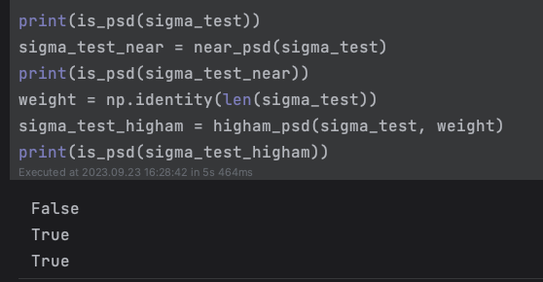
Problem 2
chol_psd(),
near_psd(),
higham_psd() implementation and test

Slide 5
Problem 2

Slide 6
Problem 3
Two functions for multivariate normal simulation
sim_from_cov() for simulation using Cholesky factorization directly
sim_from_pca() for simulation using PCA
Four covariance metrices
ew_var_ew_cor
ps_var_ps_cor
ew_var_ps_cor
ps_var_ew_cor

Slide 7
Problem 3: error

Slide 8
Problem 3: run time

